Slide 1

Churning Out A Telecom Solution
Quick Insights into customer attrition and a potential solution for SyriaTel

Slide 2
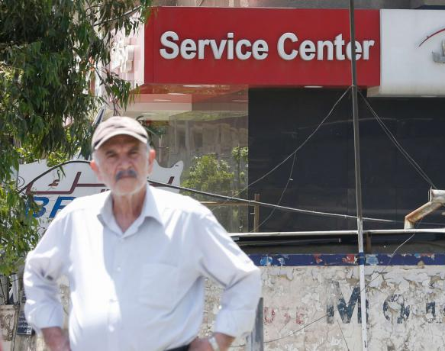
Outline
Business Problem
The Data
Methodology
Results
Recommendations

Slide 3

Business Problem
Determine why SyriaTel is experiencing a 15% churn rate and propose a potential solution to halt the attrition.

Slide 4

Data
The data contains a range of features mostly focusing on on hours of usage and charges experienced.
The largest finding when exploring data was an expected class imbalance between churners and loyal customers.

Slide 5
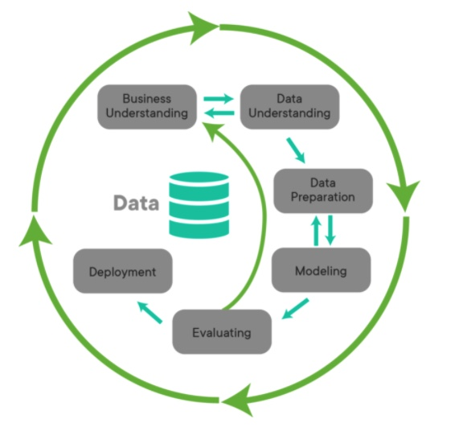
Methodology
1. Overview of Business Understanding
2. Data Understanding
3. Data Preparation
4. Modeling
5. Evaluation

Slide 6
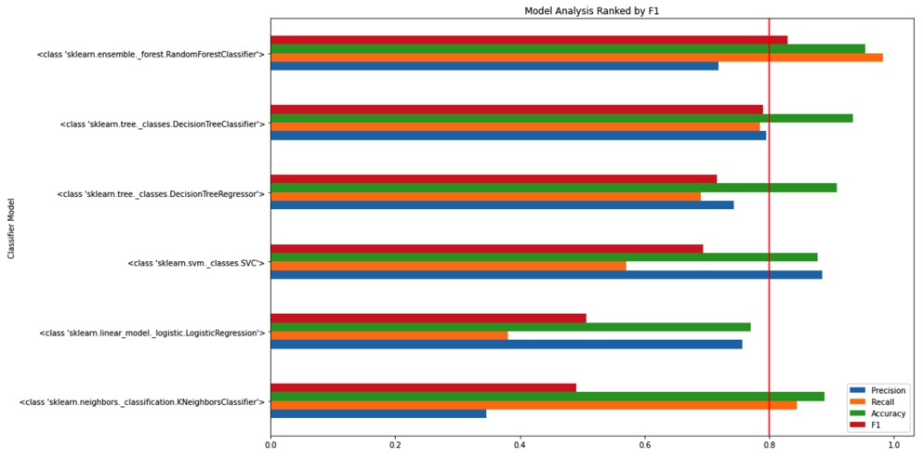
Model Metrics
Five Machine Learning Models were run in order to determine the most efficient classifier for the task
Random Forest Classifiers stood out, scoring the highest initial F1 at ~83%
This model was then isolated and optimized with grid search

Slide 7
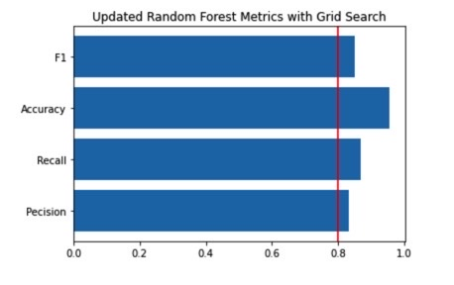
Final Model Metrics
Optimized Random Forest Metrics resulted in strong F1, Precision, Recall and Accuracy Scores:
Model Test Precision: 0.83
Model Test Recall: 0.87
Model Test Accuracy: 0.95
Model Test F1: 0.85

Slide 8
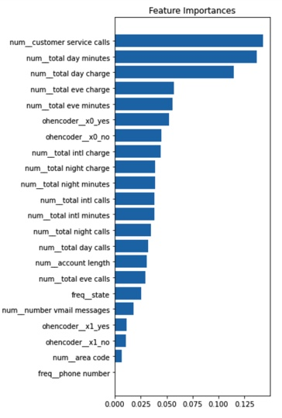
Feature Importance Analysis
The Model highly prioritizes the total number of Service Calls, Day Minutes and Day Charges
This clearly indicates that customers with high usage are not having their needs met
This also highlights that SyriaTels most valuable customers are the customers that are churning out

Slide 9
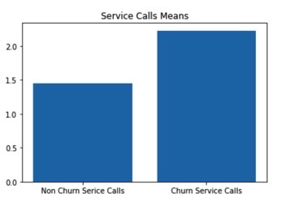
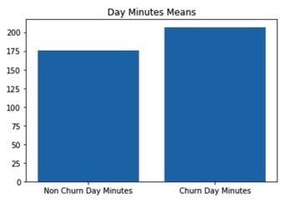
Usage and Customer Service Calls by User Type
Churners were 16% more active then their Non Churner counter parts
Churners were also X% more likely to call customer service than their Non Churner counter parts

Slide 10

Recco / Deployment:
Establish a higher tier of customer service for high usage customers
Scale charges as users enter the 16th percentile of usage in order to stifle churning and retain high value customers

